Slide 1
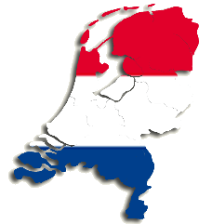
The political system of Holland
Made by
Jinke Siebring & Archana Chedoe

Slide 2
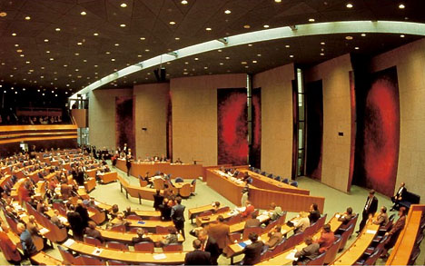
Voting rights
Election
2th chamber

Slide 3
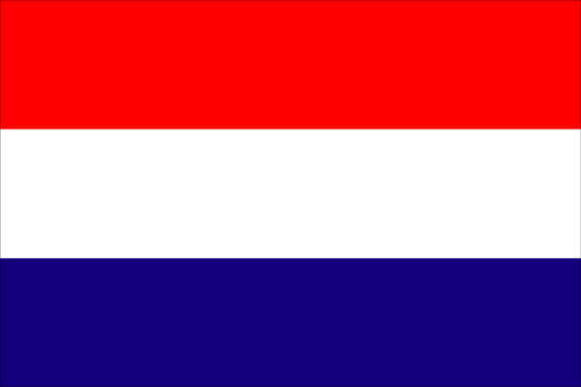
Progressive
Left
Right
Conservative

Slide 4
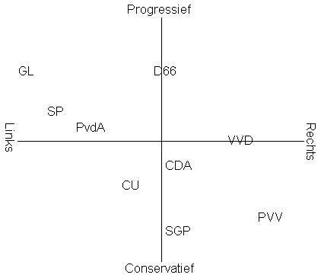
Political factions

Slide 5
Factions | Positions
VVD | They want to stimulate interest in entrepreneurship by making unnecessary rules and high taxes to leave out
PvdA | They stand for the rights of workers
PVV | They will stop the mass immigration, and against the Islamization of society
D66 | They are free thinking, and wants the walls of society counter
Groen Links | They want an environmentally friendly society Socialism
Partij van de Dieren | They stand for animal rights

Slide 6
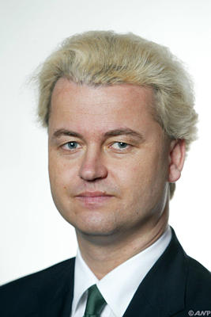
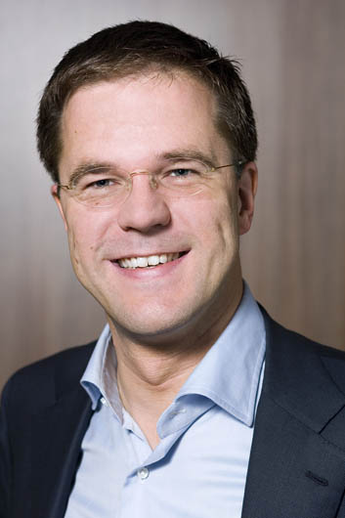
Some politicians
VVD
Mark Rutte
PVV
Geert Wilders

Slide 7
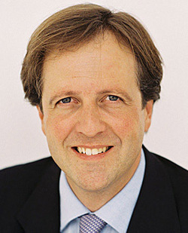
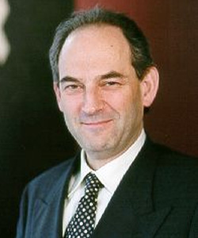
Some politicians
PvdA
Job Cohen
D66
Alexander Pechtold

Slide 8
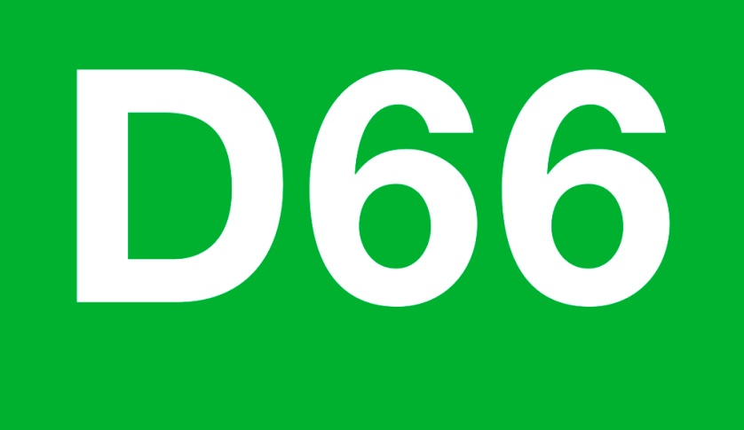
Jinke
Archana

