Slide 1
Geographic information
Made by: Jennifer, Amelda & Dinanda

Slide 2
Table of contents
The Netherlands
Laren Gld
Apeldoorn
Deventer

Slide 3
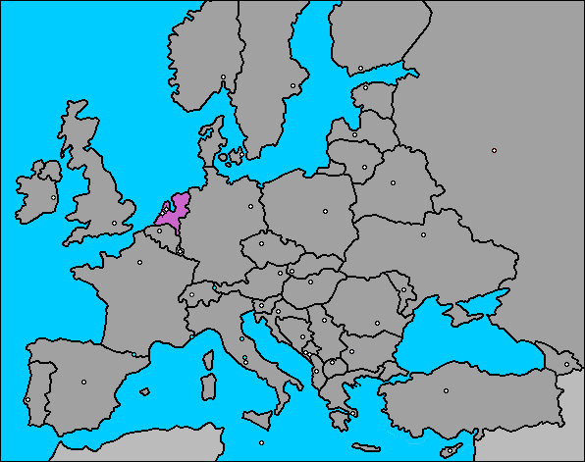
Map of Europe

Slide 4
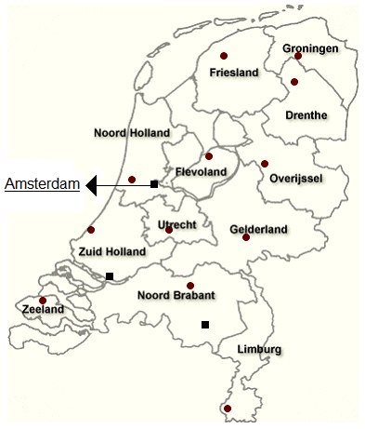
Map of the Netherlands
Population:
16.7 million
Language:
Dutch

Slide 5
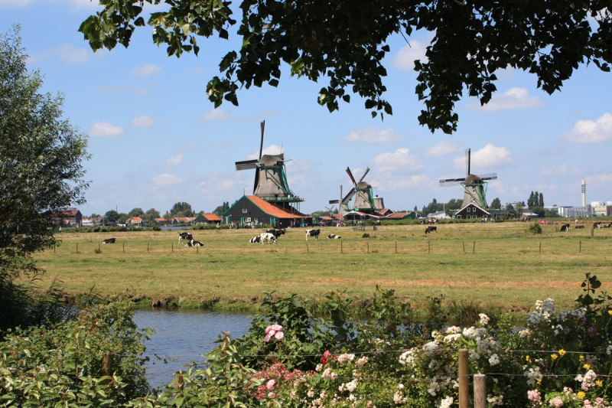
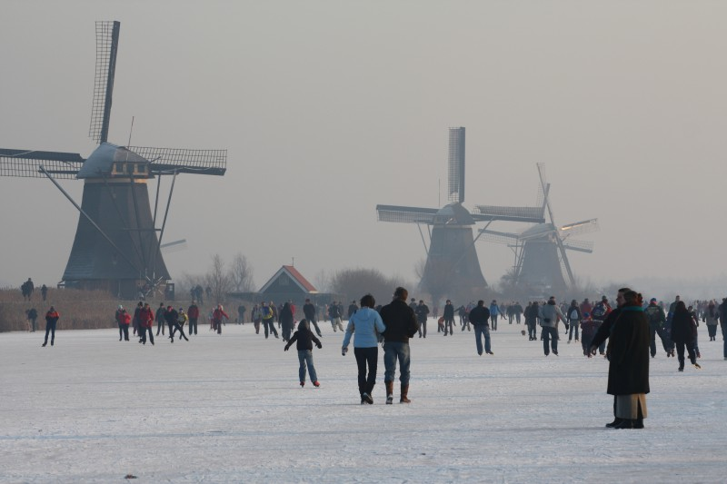
The Dutch weather
Cool summers
Soft winters
Sea climate

Slide 7
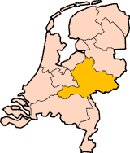
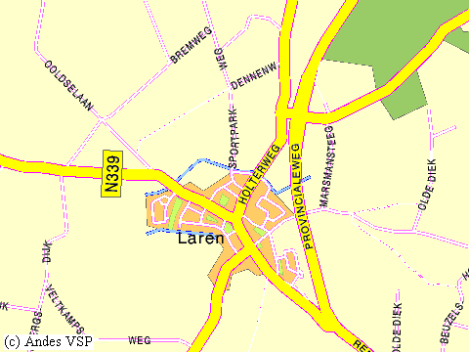
Laren Gld.
Population: 4000

Slide 8
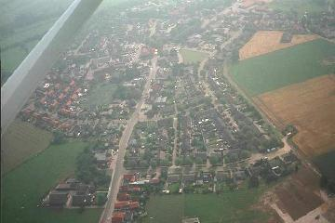
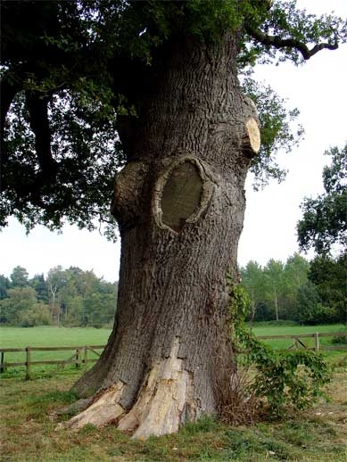
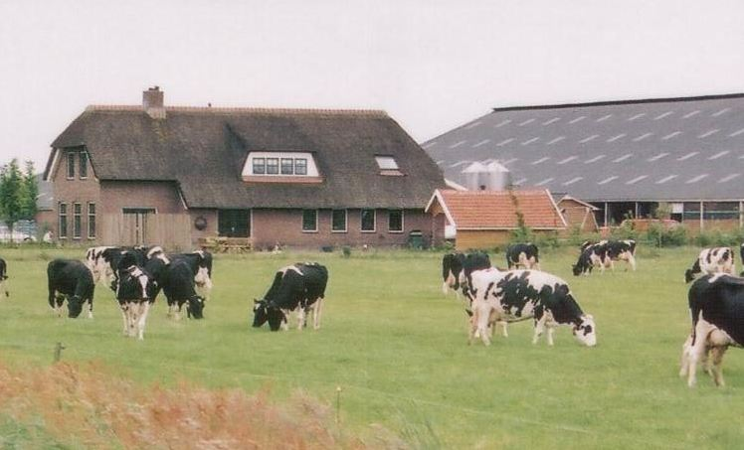
Laren Gld

Slide 9
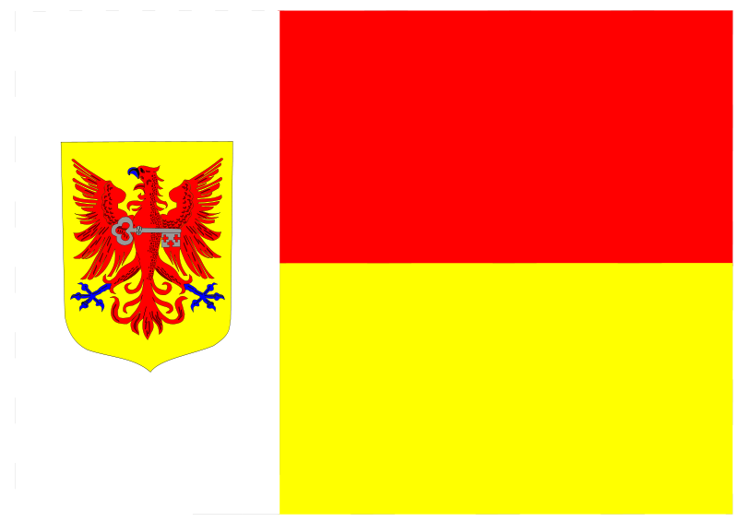
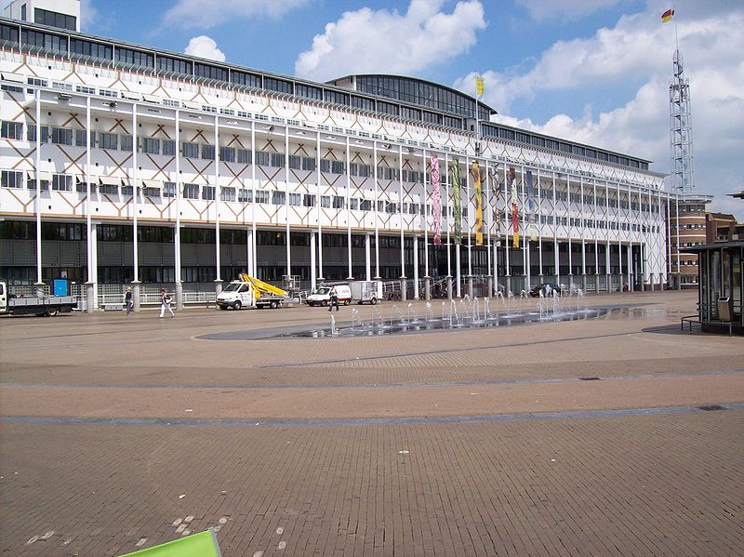
Apeldoorn
City hall
Flag of Apeldoorn

Slide 10
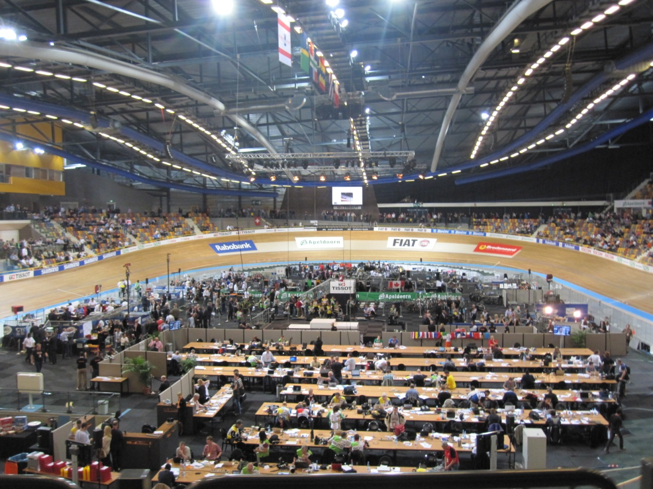
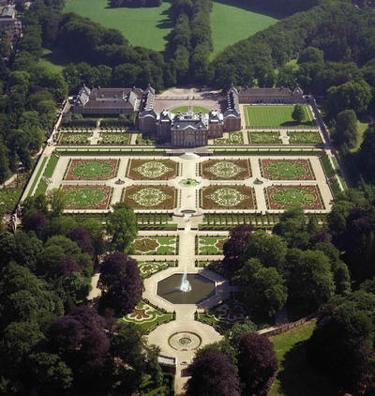
UCI Track Cycling World Championships at Omnisport
Royal palace

Slide 11
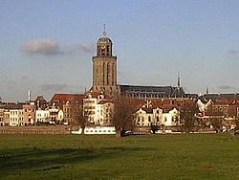
Deventer

Slide 12
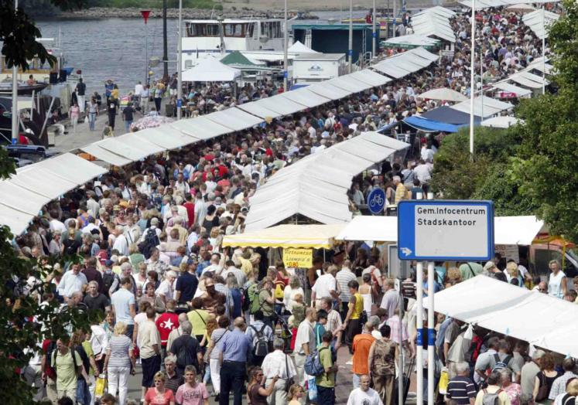
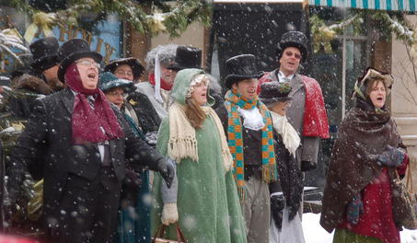
The bookfair
The Charles Dickens festival

Slide 13
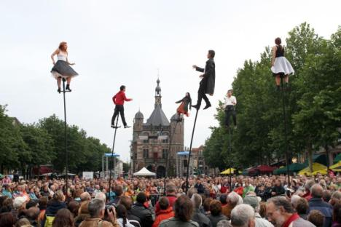
Deventer on stillts
http://www.youtube.com/watch?v=hC3cCGScIRA

Slide 14
Economical information
Made by Amber and Patricia

Slide 15
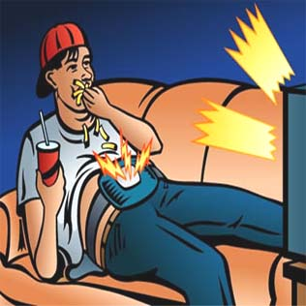
Teenagers unemployment
Side job

Slide 16
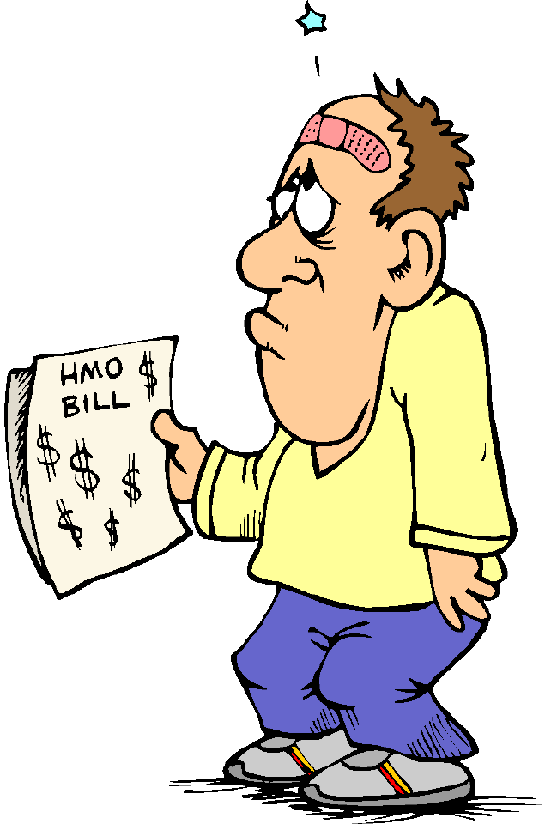
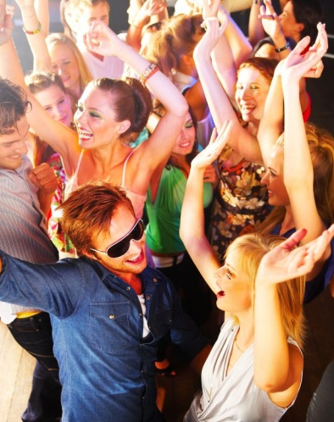
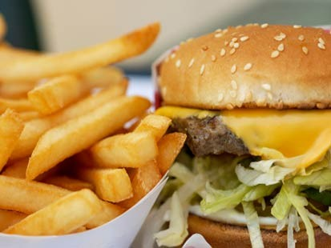
Health incurance act.
Student grant

Slide 17
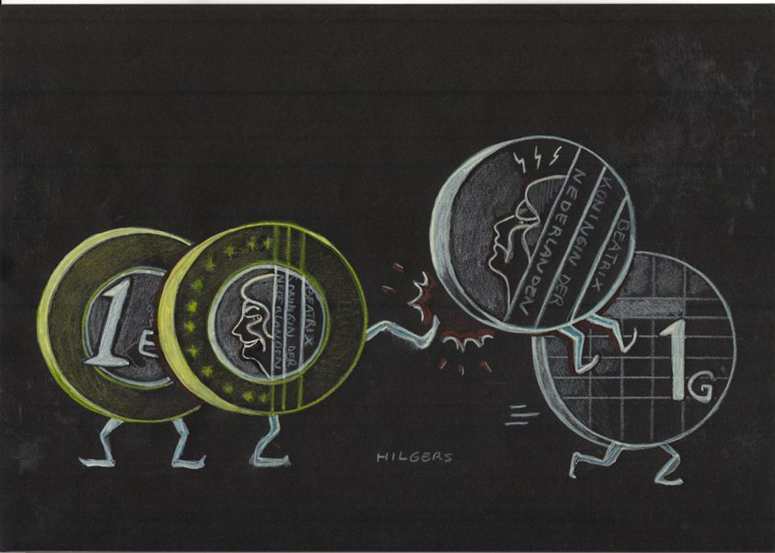
Bye bye guilder!!!

Slide 18
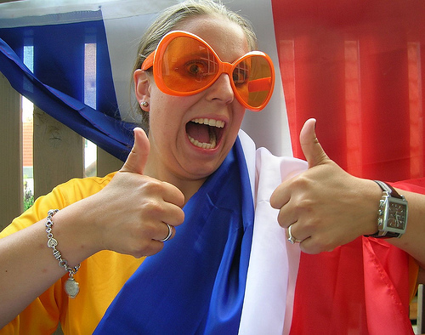
Go Holland!!!

