Slide 1
Tourism in The Netherlands

Slide 2
Who are we?
Mirna Bussink
Annemiek Langeler
Roy Vennebeumer
Diewertje Schut

Slide 3
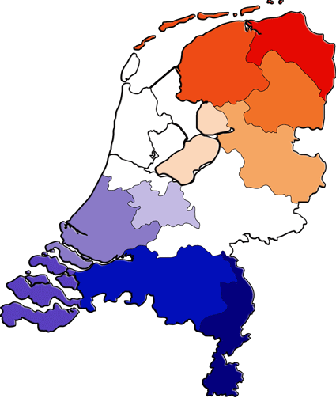
Content
Who are we?
The Netherlands
Chees, clogs and tulips
Amsterdam
Volendam

Slide 4
Netherlands
Small country
16.000.000 residents
Typical Dutch
Water

Slide 5
Cheese, clogs and Tulips
Cheese market Alkmaar
Keukenhof

Slide 6
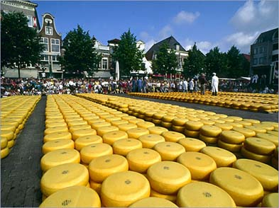
Cheese market alkmaar

Slide 7
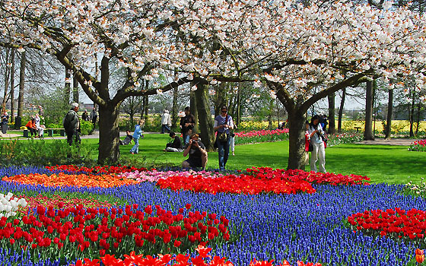
Keukenhof Tulips

Slide 8
Amsterdam
De wallen
The canals
Coffeeshops

Slide 9
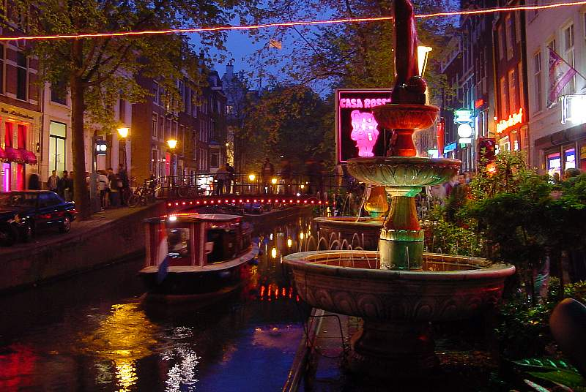
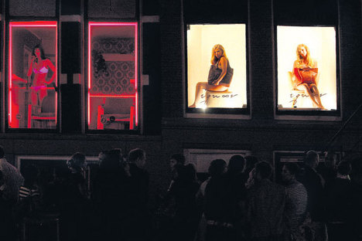
De Wallen

Slide 10
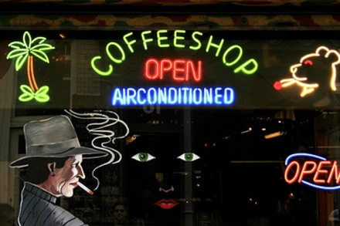
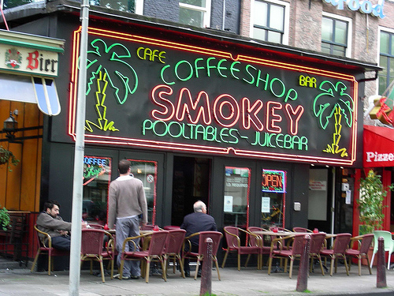
Coffeeshops

Slide 11
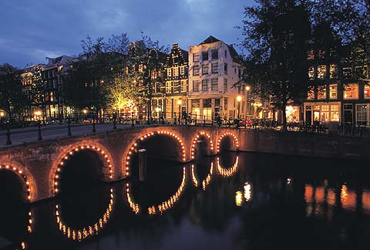
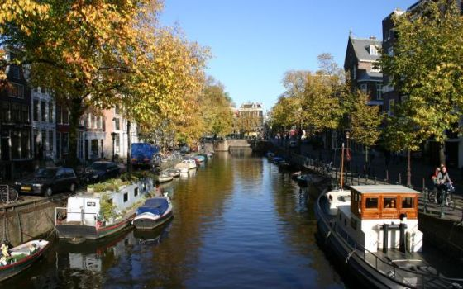
The Canals of Amsterdam

Slide 12
Volendam
Small fishing village
Many Dutch singers ‘palingsound’
Typical Volendamse costumes

Slide 13
Palingsound

Slide 14
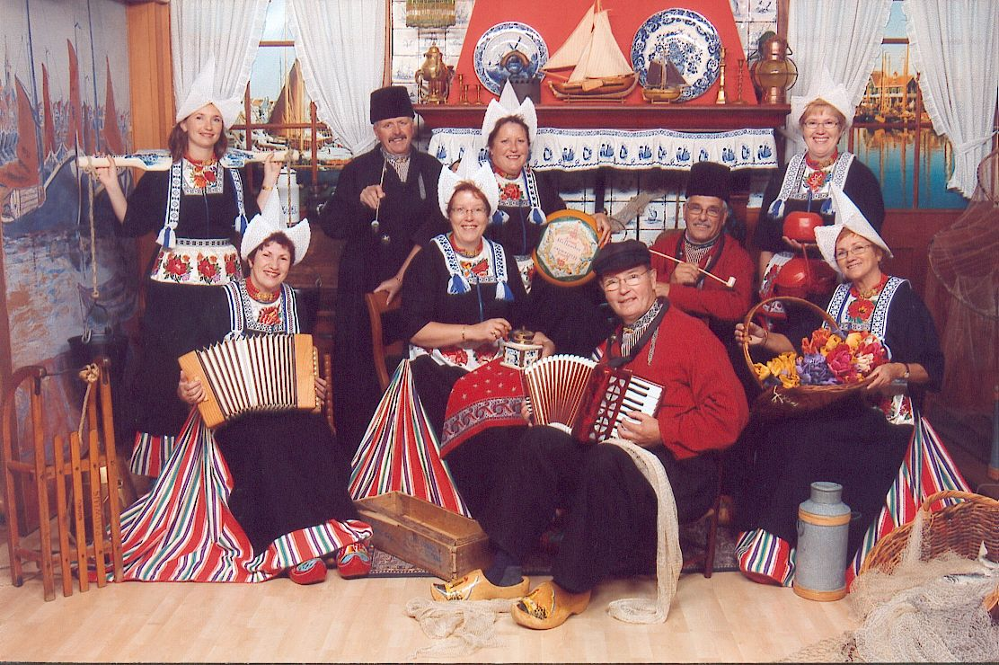
Volendamse Costumes

Slide 15
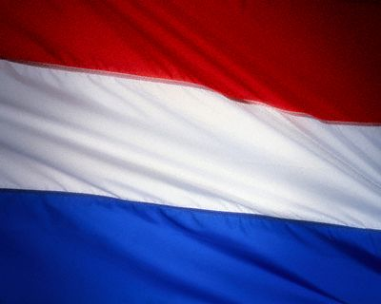
The End

